Slide 1
Fundamentals of Management
Week 1

Slide 2
What does management mean to you?

Slide 3
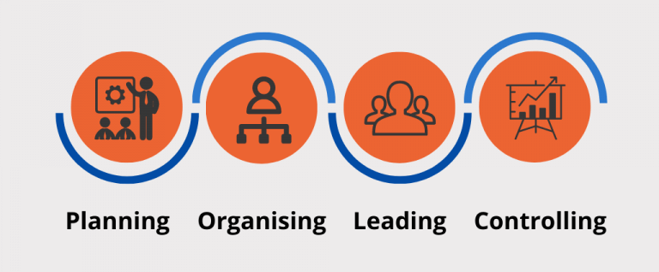

Slide 4
The Definition
“ The process of achieving organizational goals and objectives effectively and efficiently through planning, organizing, leading and controlling the human, material and financial resources available to it.”

Slide 5
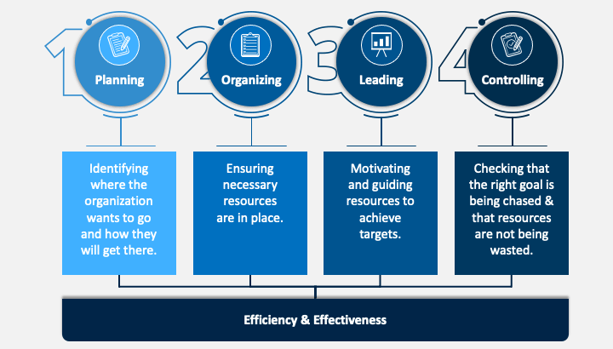

Slide 6
The History

Slide 7
Management Schools
Theoretical frameworks for the study of management, based on different assumptions about human beings and the organizations for which they work.
Classical School
Behavioral School
Quantitative School
Systems School
Contingency School

Slide 8
Classical School 1880s
Managing workers and organizations more efficiently
Scientific Management-1880s
Administrative Management-1940s
Bureaucratic Management-1920s

Slide 9
Classical School 1880s
Scientific Management (Frederick W. Taylor):
Systematic study of work methods in order to improve efficiency.
Principles:
Application of the scientific method to work in order to determine the best method for accomplishing each task.
Workers should be scientifically selected based on their qualifications and trained to perform their jobs in the optimal manner.
Scientific management advocates genuine cooperation between workers and management based on mutual self-interest.
Management should take complete responsibility for planning the work and that workers' primary responsibility should be implementing management's plans.
Scientific development of difficult but fair performance standards and the implementation of a pay-for-performance incentive plan based on work standards.

Slide 10
Classical School 1880s
Administrative Management (Henry Fayol):
Studies the management process and principles of management.
Principles:
Management is a universal process consisting of functions; planning, organizing, commanding, coordinating, and controlling.
All managers performed these functions and that the functions distinguished management as a separate discipline of study apart from accounting, finance, and production.
Fourteen principles of management, including maxims related to the division of work, authority and responsibility, unity of command and direction, centralization, subordinate initiative, and team spirit.

Slide 11
Classical School 1880s
Bureaucratic Management (Max Weber):
Studies the ideal form of organization. Many early organizations were inefficiently managed, with decisions based on personal relationships and loyalty.
Principles:
A form of organization, called a bureaucracy, characterized by division of labor, hierarchy, formalized rules, impersonality, and the selection and promotion of employees based on ability, for a more efficient management.
Managers' authority in an organization should be based not on tradition or charisma but on the position held by managers in the organizational hierarchy.

Slide 12
Behavioral School 1930s
Understanding human behavior in the organization.
Human Relations-1930s
Behavioral Science-1950s

Slide 13
Behavioral School 1930s
Human Relations (Hawthorne Experiments)
Focus on assisting employees in adjusting to organizational life by fostering collaborative systems between labor and management.
Principles:
Manager should possess skills for diagnosing the causes of human behavior at work, interpersonal communication, and motivating and leading workers, to satisfy their needs and make them more productive.
Work on issues of communication, leadership, motivation, and group behavior.

Slide 14
Behavioral School 1930s
Behavioral Science (Gordon & Howell 1959 report)
Focus on personality, attitudes, values, motivation, group behavior, leadership, communication, and conflict among other issues.
Principles:
Application of conceptual and analytical tools to the problem of understanding and predicting behaviour in the workplace.
Management practitioners should understand human behaviour.

Slide 15
Quantitative School 1940s
Increasing quality of managerial decision-making through the application of mathematical and statistical methods
Management Science-1940s
Operations Management-1940s
Management Information Systems-1950s-1970s

Slide 16
Quantitative School 1940s
Management Science (Operations Research) & MIS
Uses mathematical and statistical approaches to solve management problems. The advent of computer made many management science tools and concepts more practical for industry.
MIS focuses on providing needed information to managers in a useful format and at the proper time.
Decision Support System (DSS) attempt to integrate decision models, data, and the decision maker into a system that supports better management decisions.
Programmes developed to determine optimal allocation of scarce resources (linear programming).
Tools include inventory control theory, goal programming, queuing models, and simulation.
Notes:
Developed in WWII

Slide 17
Quantitative School 1940s
Production & Operations Management (W. Edwards Deming)
Focuses on the operation and control of the production process that transforms resources into finished goods and services
Operations management emphasizes productivity and quality of both manufacturing and service organizations.
Major areas of study within operations management include:
capacity planning, facilities location, facilities layout, materials requirement planning, scheduling, purchasing and inventory control, quality control, computer integrated manufacturing, just-in-time inventory systems, and flexible manufacturing systems.
Notes:
Developed in WWII

Slide 18
Systems School 1950s
Understanding the organization as a system that transforms inputs into outputs while in constant interaction with its’ environment (Ludwig von Bertalanffy)
A way of thinking about managing techniques that would allow managers to relate different specialties and parts of the company to one another, as well as to external environmental factors.
It focuses on the organization as a whole, its interaction with the environment, and its need to achieve equilibrium.
General systems theory received a great deal of attention in the 1960s, but its influence on management thought has diminished somewhat. It has been criticized as too abstract and too complex.

Slide 19
Contingency School 1960s
Applying management principles and processes as dictated by the unique characteristics of each situation
There is no one best way to manage and that it depends on various situational factors, such as the external environment, technology, organizational characteristics, characteristics of the manager, and characteristics of the subordinates.
It has been applied primarily to management issues such as organizational design, job design, motivation, and leadership style.

Slide 20
Contemporary Schools
Modern and advanced approaches towards the study of management, offering additional insights into the management field.
Total Quality Management
Learning Organization

Slide 21
Contemporary Schools
Total Quality Management (TQM) focuses on managing the entire organization to deliver quality goods and services to customers (W Edwards Deming)
Employee involvement is essential in preventing quality problems before they occur.
A customer focus means that the organization must attempt to determine customer needs and wants and deliver products and services that address them.
Benchmarking means that the organization is always seeking out other organizations that perform a function or process more effectively and using them as a standard, or benchmark, to judge their own performance. The organization will also attempt to adapt or improve the processes used by other companies.
A philosophy of continuous improvement means that the organization is committed to incremental changes and improvements over time in all areas of the organization.

Slide 22
Contemporary Schools
Learning Organization is one in which all employees are involved in identifying and solving problems (Peter Senge).
Allows the organization to continually increase its ability to grow, learn, and achieve its purpose.
The organizing principle is not efficiency, but problem solving.
Key aspects are a team-based structure, empowered employees, and open information.

Slide 23
Assignment
How has the role of manager evolved with advancements in technology? Discuss the pros and cons of using technology for managing employees in an organization?
Word Count: 1500
Marks: 20
Weightage: 5
Submission: Sunday, 6th March 2022

Slide 24
Assignment Guidelines
Strict adherence to the word count, a leeway of only +- 10% will be given.
No plagiarism will be accepted.
Use Harvard Style Referencing for both in text and bibliography
Bibliography is not included in the word count
Missing deadline will result in F

